Slide 1
Explainable AI
4/16

Slide 2
Background
Typical DL papers:
Model as a result of optimization
Do ablation studies
Explainability is to understand everything? IMPOSSIBLE
Target-oriented:
Real application
Customers need explanation
Further understanding for researchers
Know what is learned by optimization and what is not
Debugging & Manipulating & Improving

Slide 3
Outline
Explain a trained model: common tools & their applications
Attribution
Probing
Heatmap
Create an explainable model: focus on CNN
Constraining activation maps
Encoding prior

Slide 4
Explain a trained model

Slide 5
Attribution
Local v.s. Global attribution
Completeness
Evaluation

Slide 6
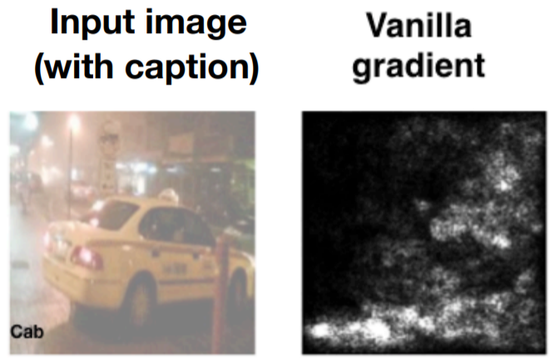
What and why attribution?
What
Importance assignment for each input
How each INPUT influences OUTPUT in an end-to-end fashion
Why
Know how model utilizes input to produce output
Useful for both customers and researchers

Slide 7
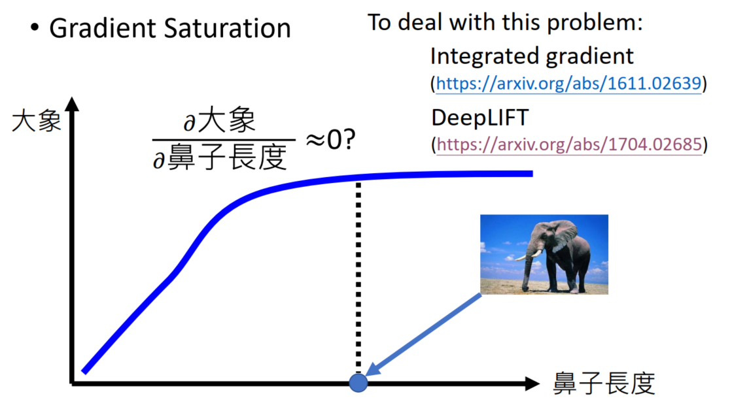
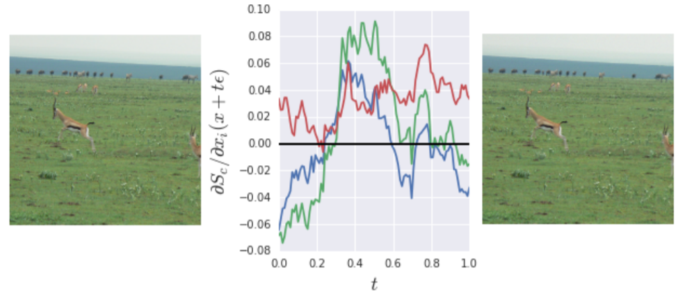
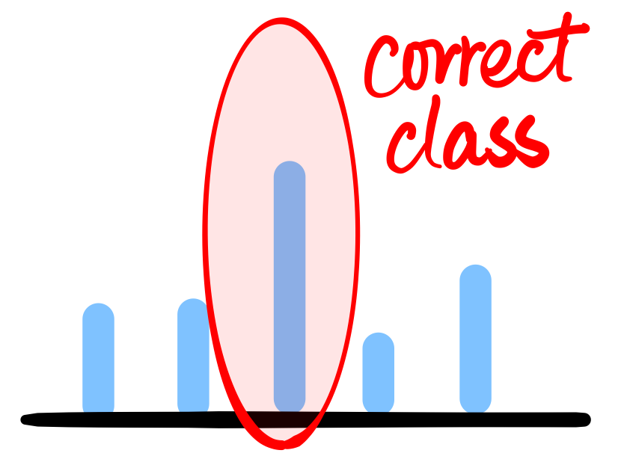
Local gradient-based
Grad-Cam: vallina gradient
Problem:
Saturation → Solution: Global attribution
Noisy gradient → Solution: SmoothGrad

Slide 8
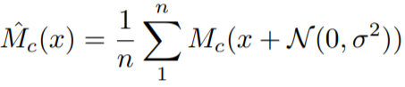
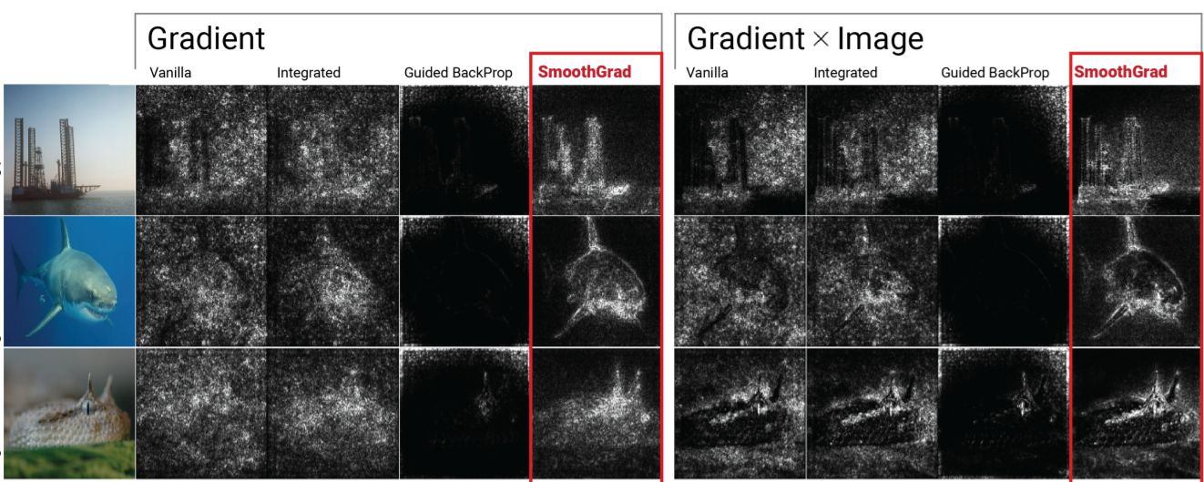
SmoothGrad
Add noise for calculate gradient
Add noise during training

Slide 9
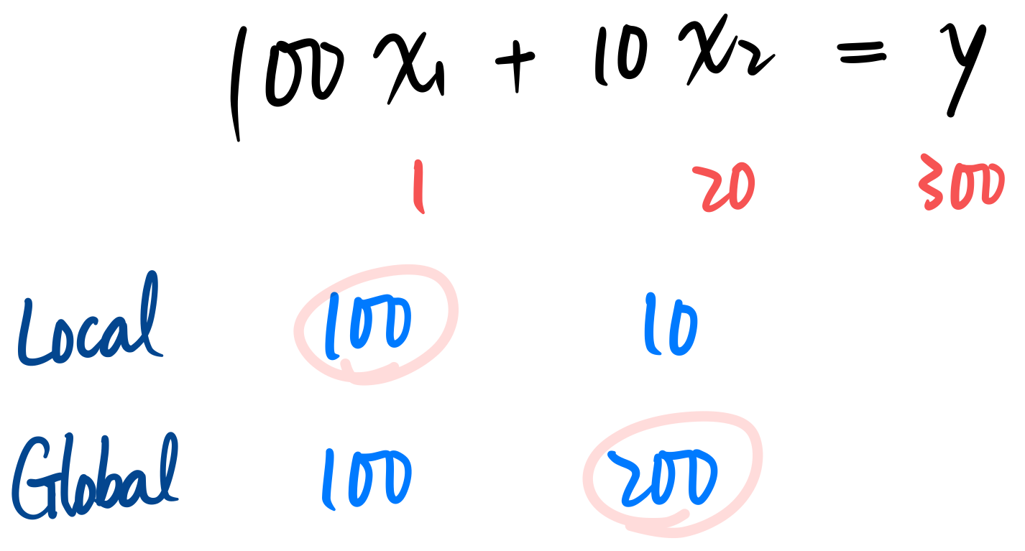
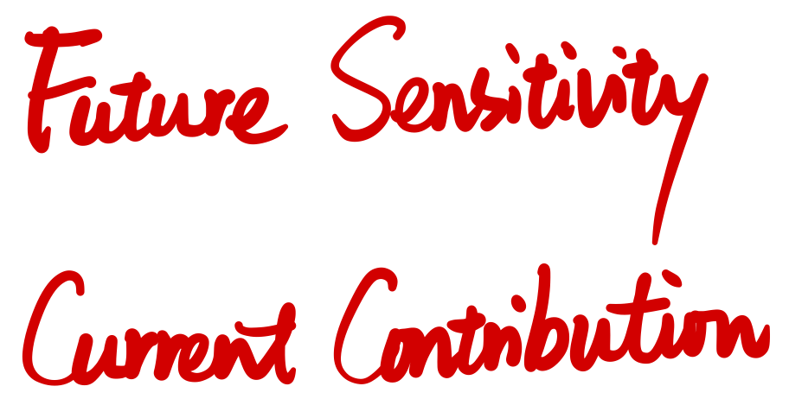
Local v.s. Global

Slide 10
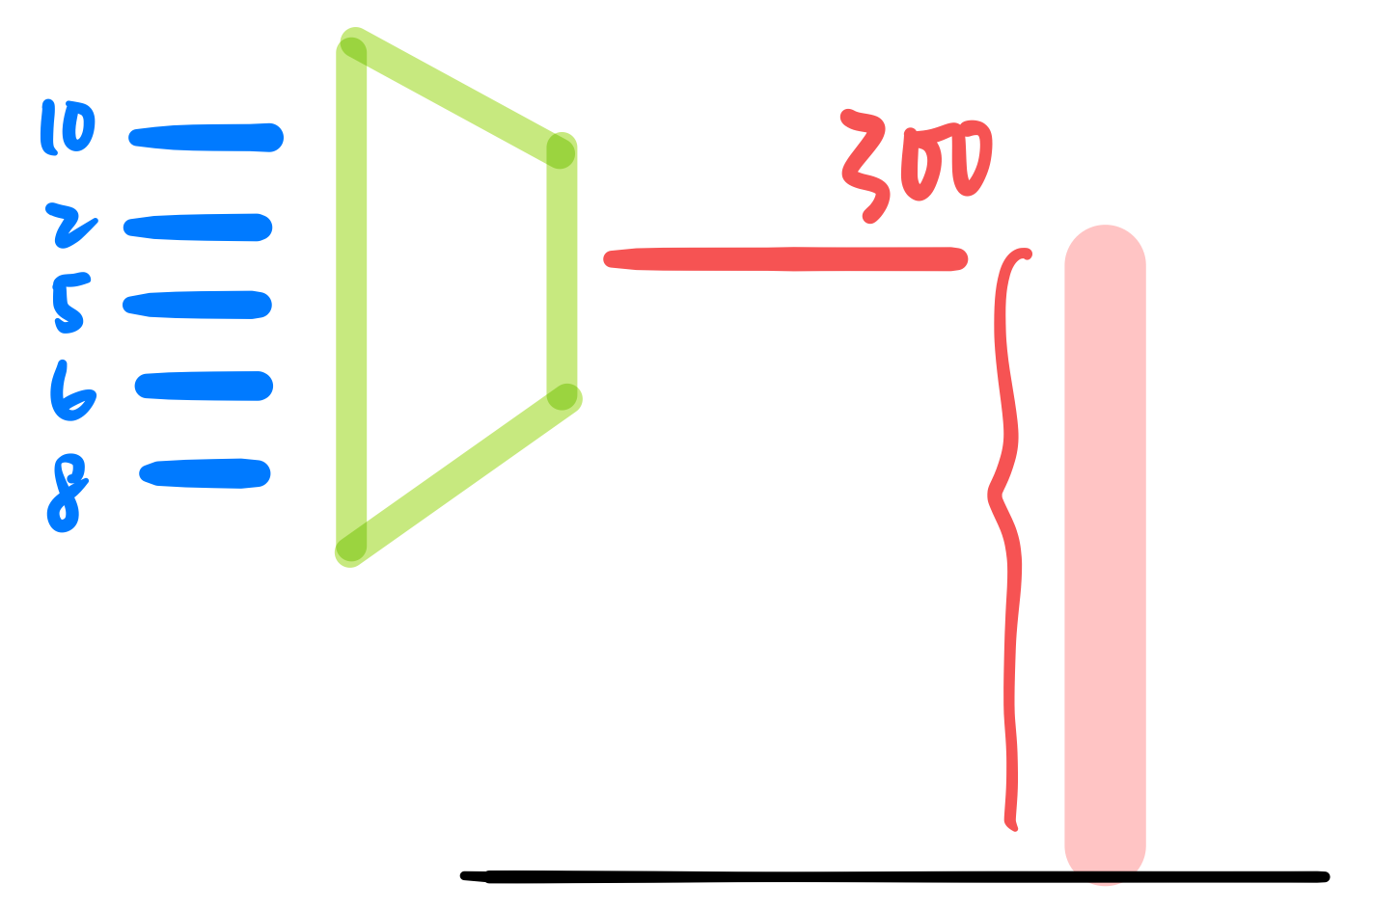
Global attribution
Spirit: attributions sum up to output

Slide 11
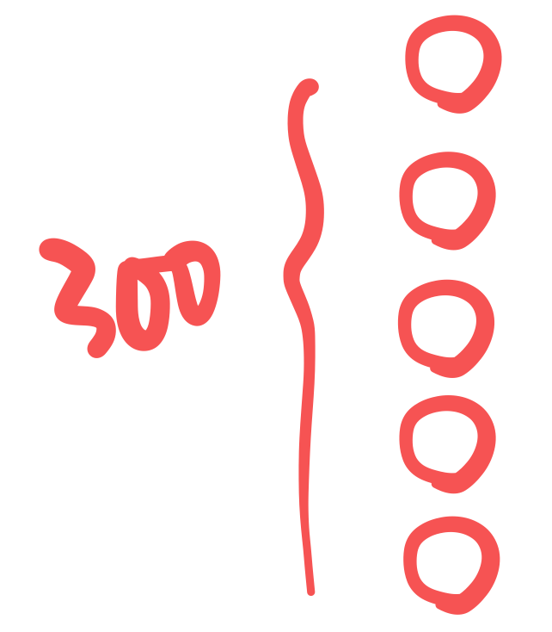
Global attribution
Spirit: attributions sum up to output

Slide 12
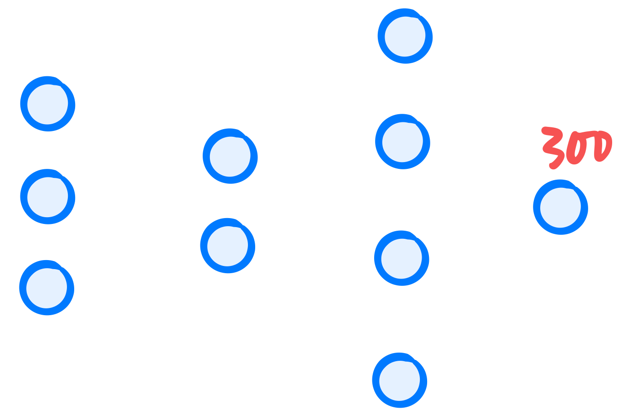
How to achieve globalness?
Layer-wise relevance propagation

Slide 13
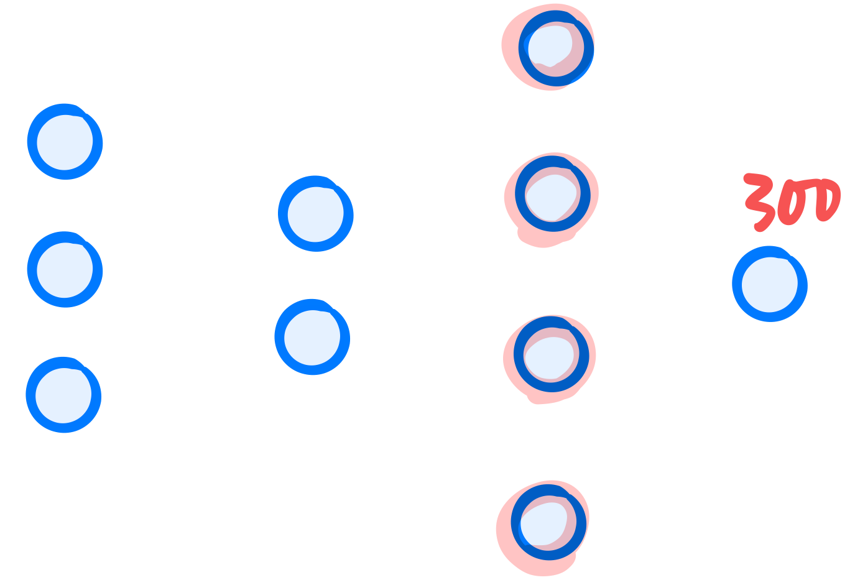
Layer-wise relevance propagation (LRP)
Locate immediate parent nodes

Slide 14
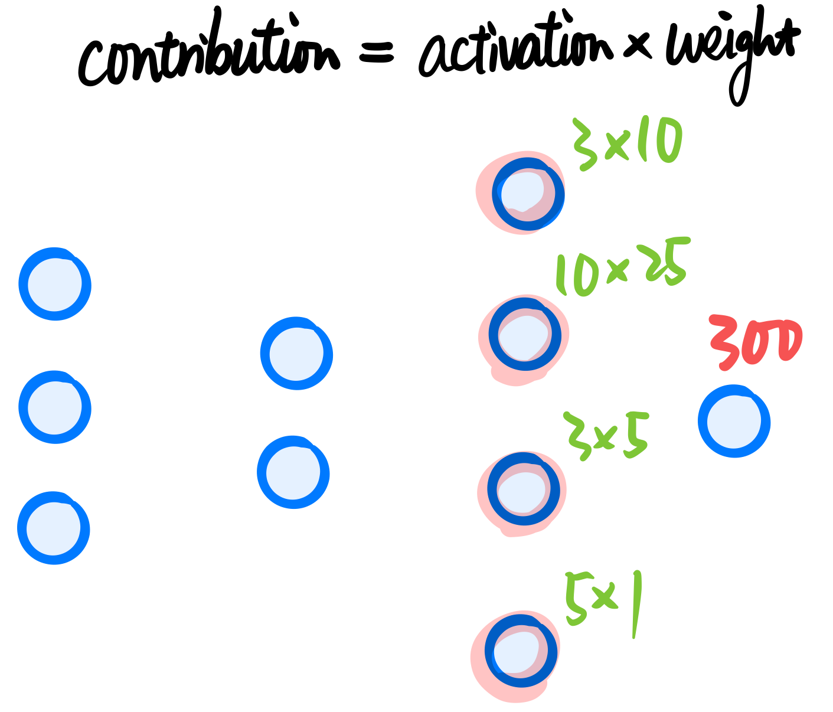
Layer-wise relevance propagation (LRP)
Calculate contributions

Slide 15
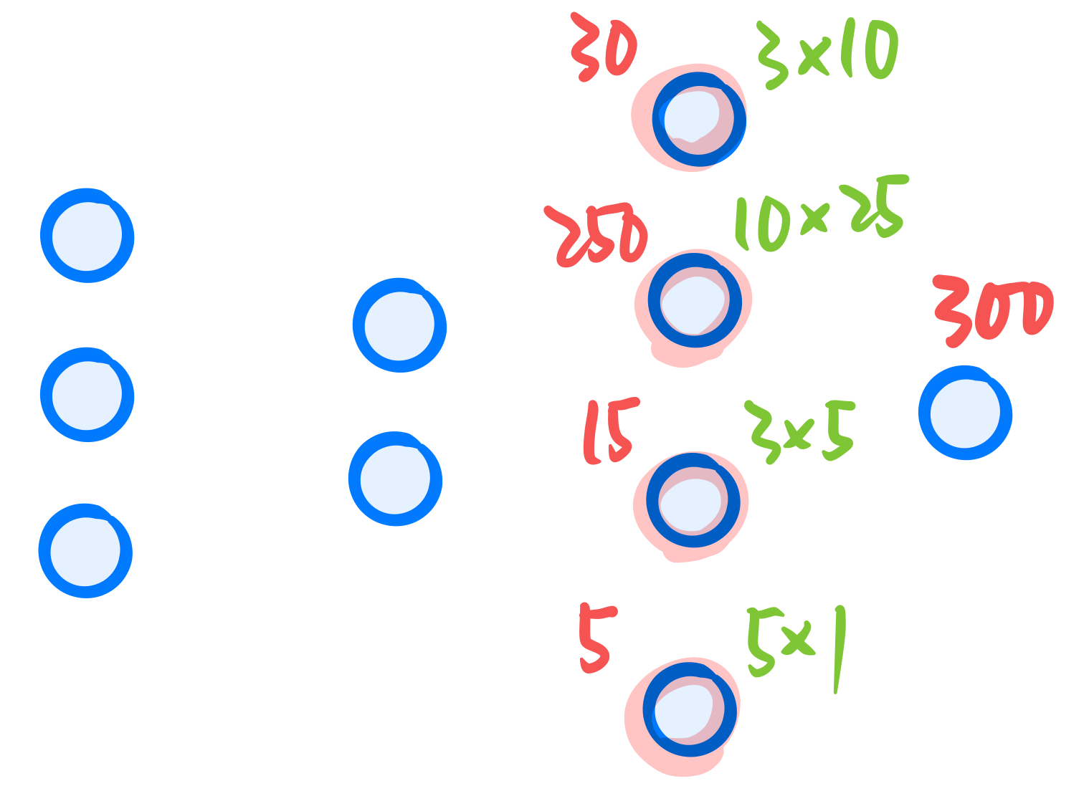
Layer-wise relevance propagation (LRP)
Redistribute the output

Slide 16
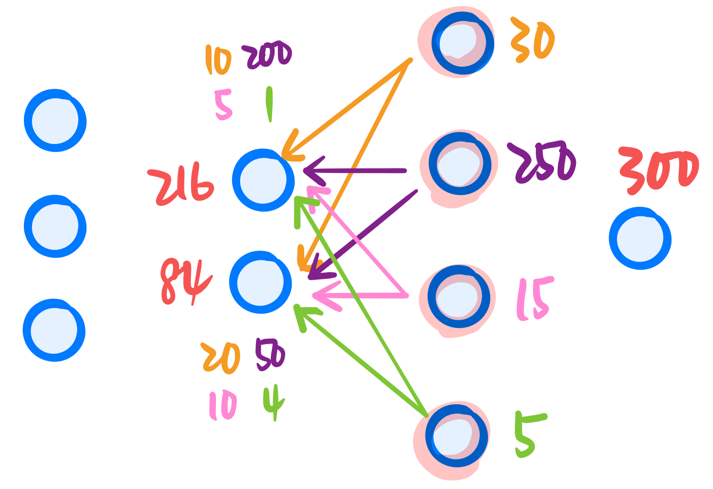
Layer-wise relevance propagation (LRP)
Backward propagation until reaching input

Slide 17
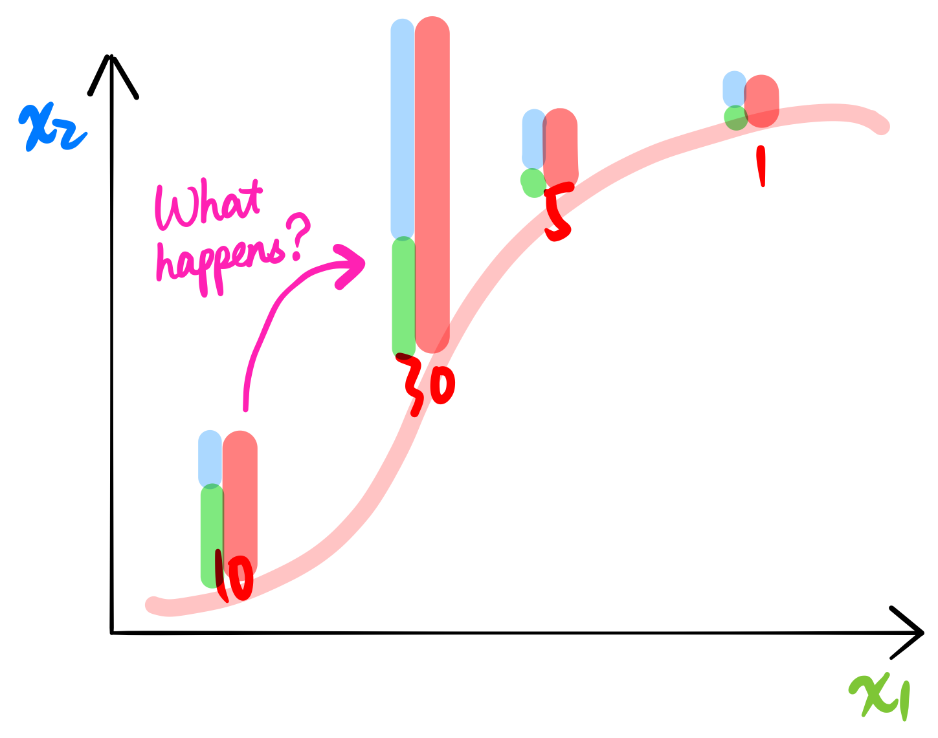
Completeness

Slide 18
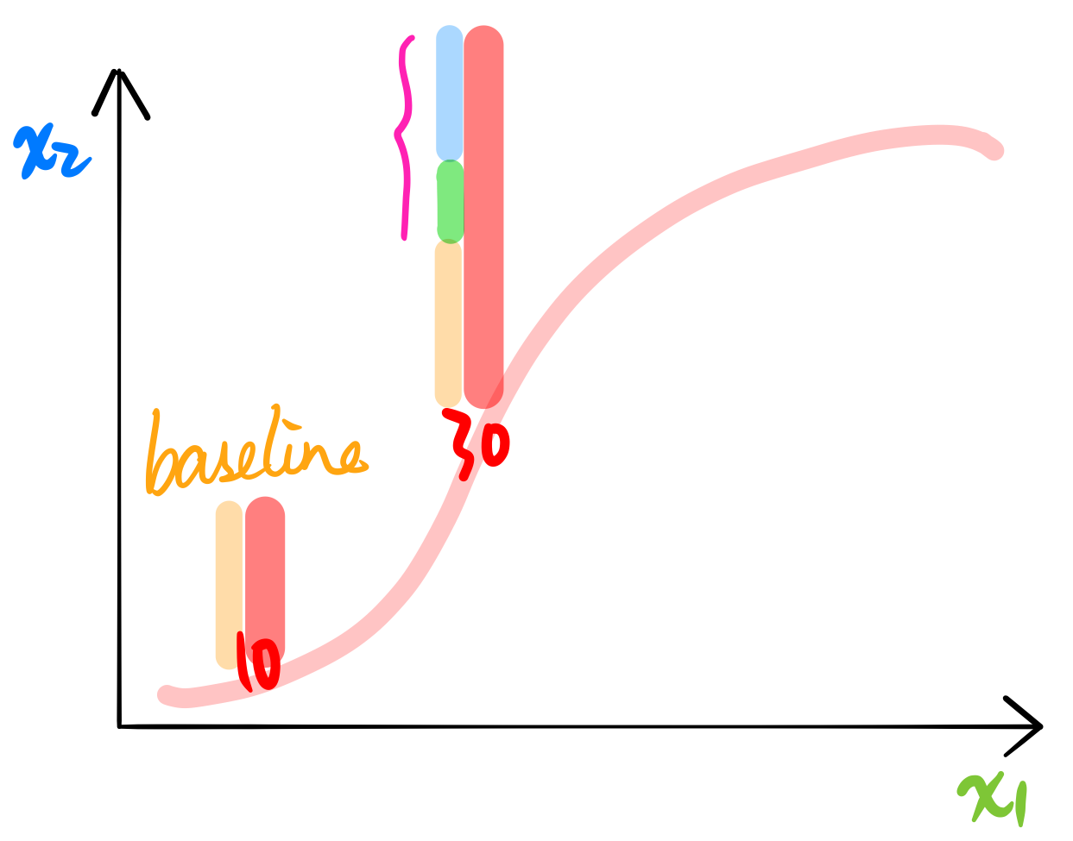
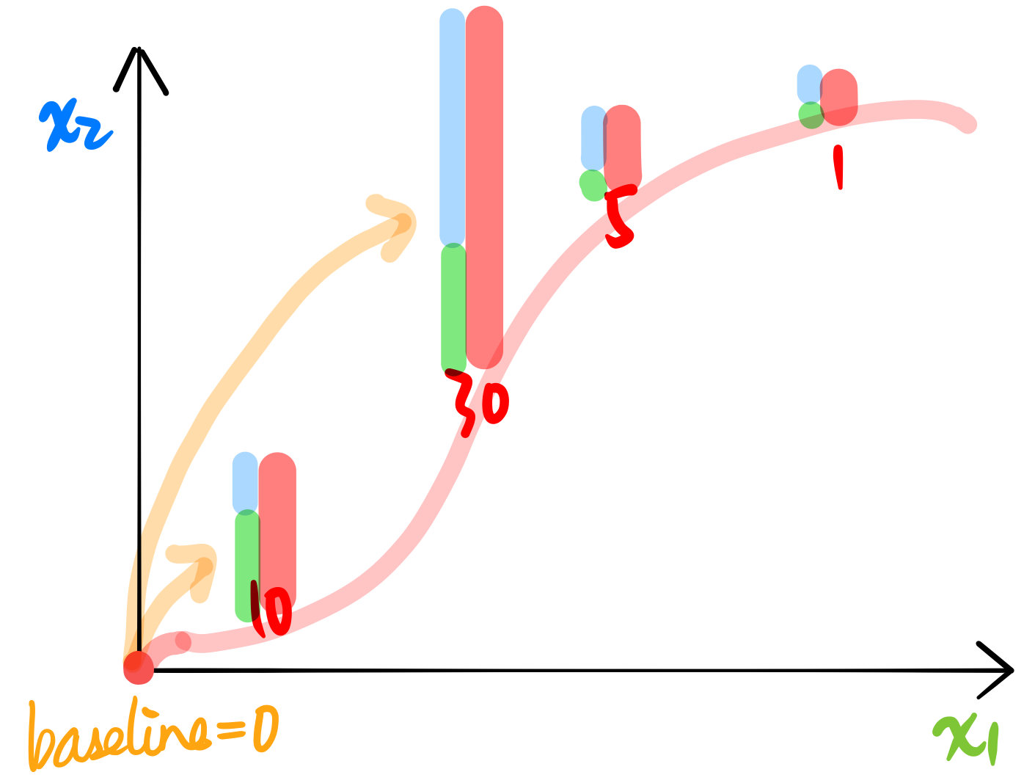
Completeness
Flexible baseline
Fixed-0 baseline → LRP when no bias

Slide 19
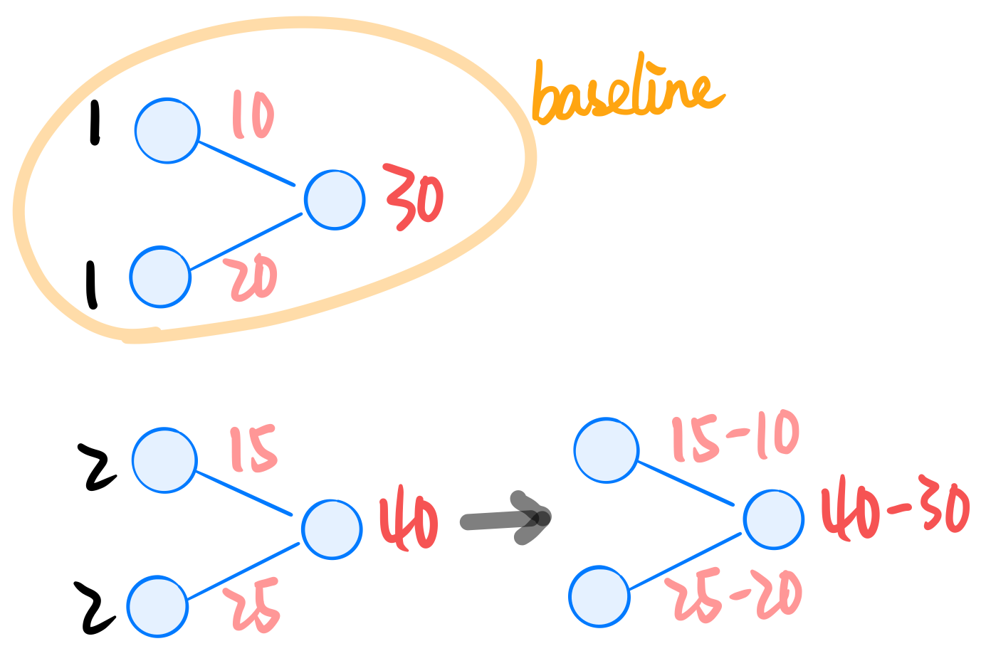
Flexible baseline → DeepLIFT

Slide 20
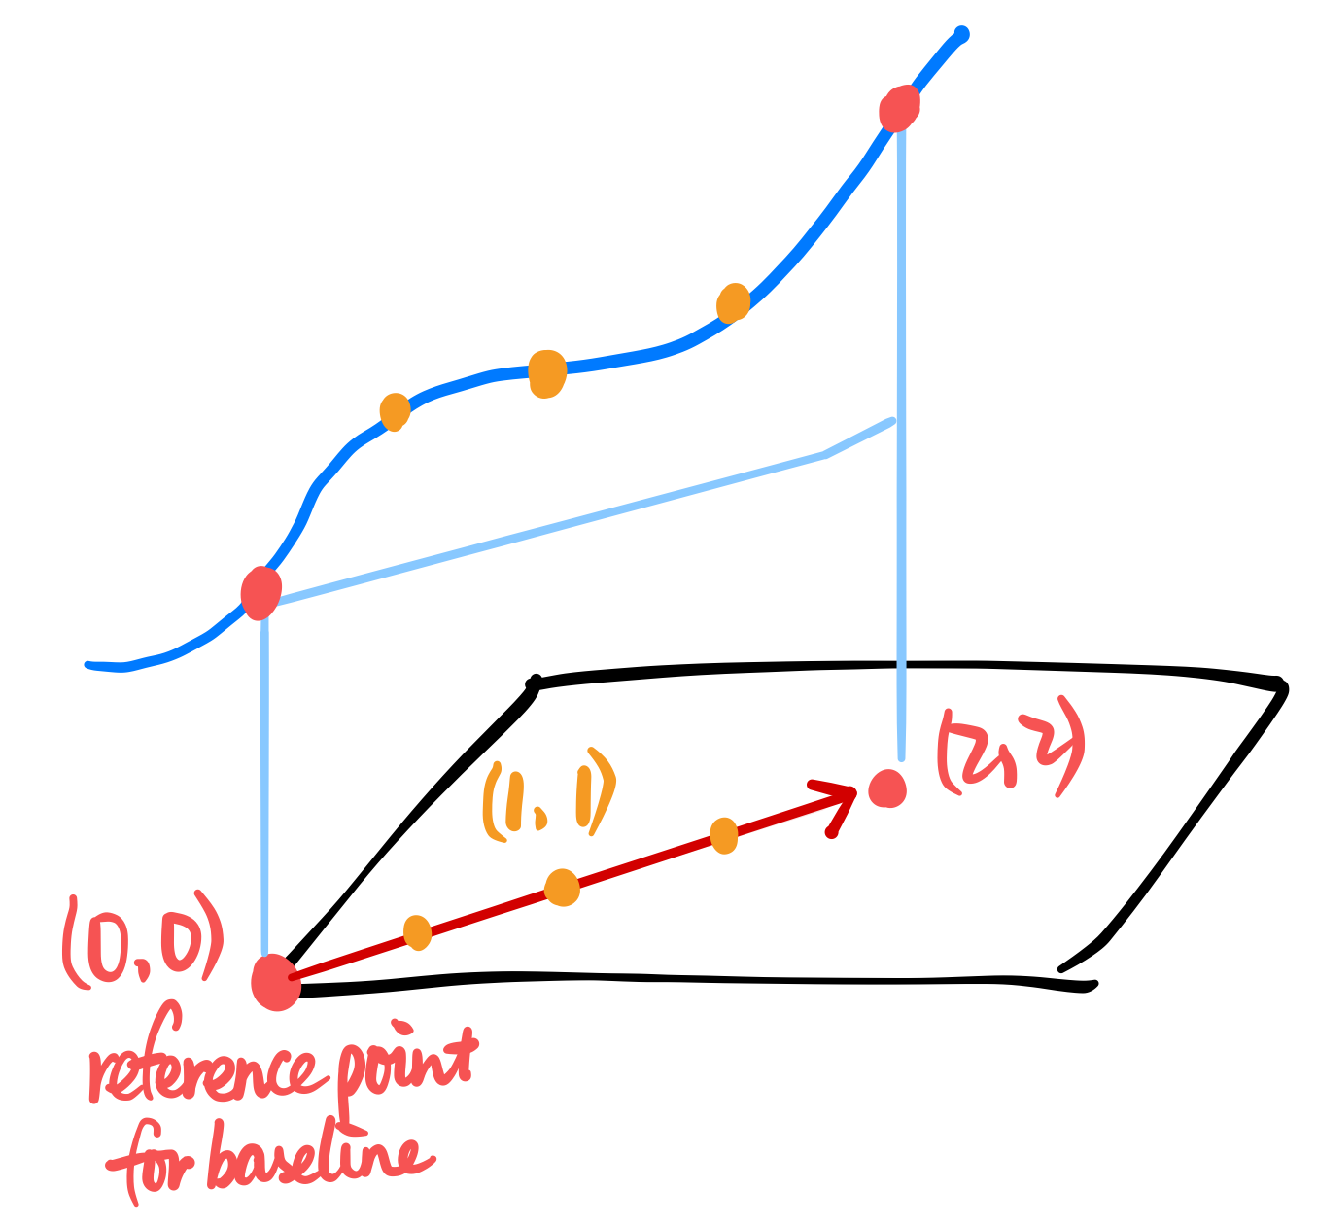
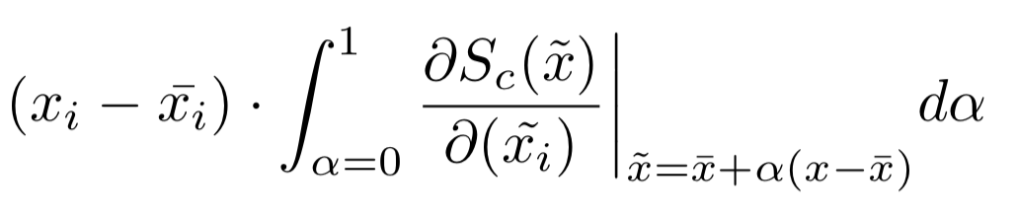
Flexible baseline → Integrated gradient
Seems complicated, actually easier implementation than DeepLIFT
But much more slower

Slide 21
Take-away message
Completeness:
Attributions sum up to current output - baseline output
Global / local attribution
Grad-Cam, SmoothGrad
LRP, DeepLIFT
Integrated gradient

Slide 22
Dilemma in developing attribution method
It works!
Does it really reflect the model or just because I tuned the algorithm?
It doesn’t work…
Does it really reflect the model or should I tune the algorithm harder?
Or… Yeah this heatmap looks great! this algorithm is so good!
Eg. Gradient * Input

Slide 23
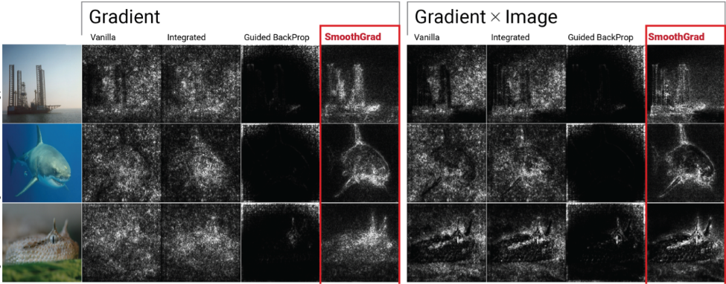
Dilemma in developing attribution method

Slide 24
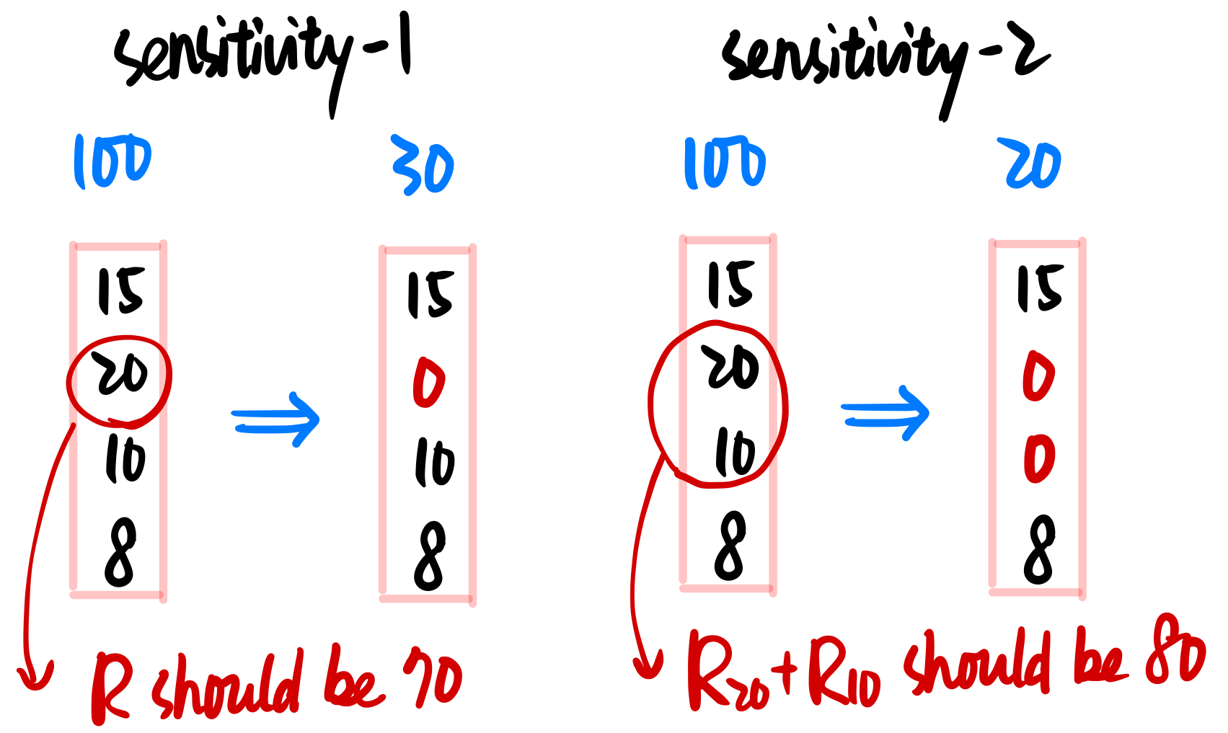
Sensitivity-n

Slide 25
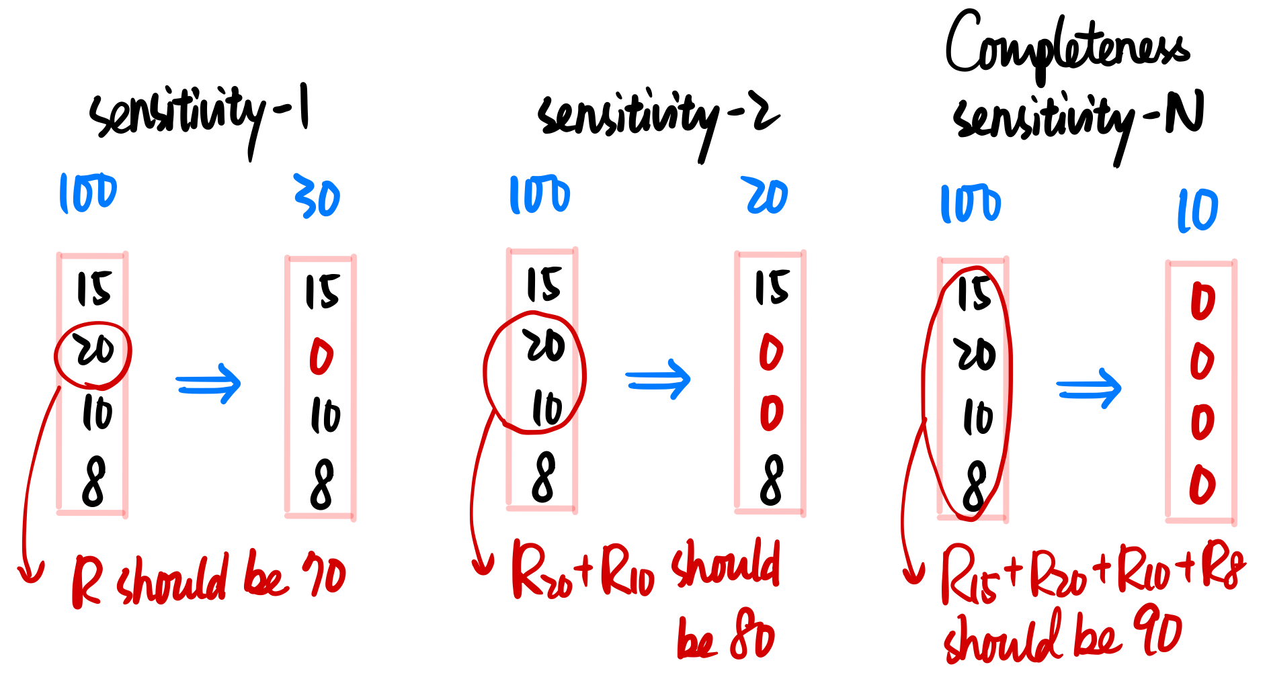
Sensitivity-n
Why should I follow this?
Cause it is just a generalized (fine-grained) version of completeness

Slide 26
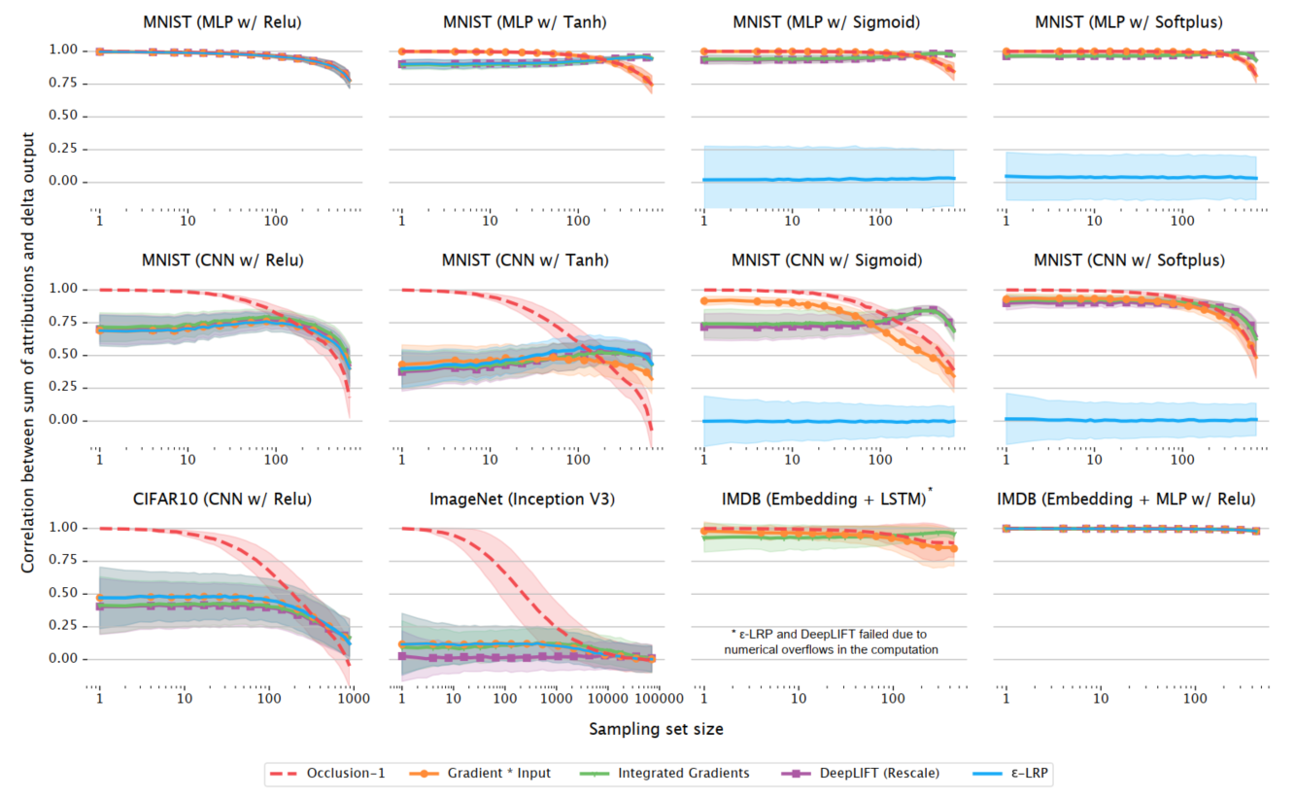

Slide 27
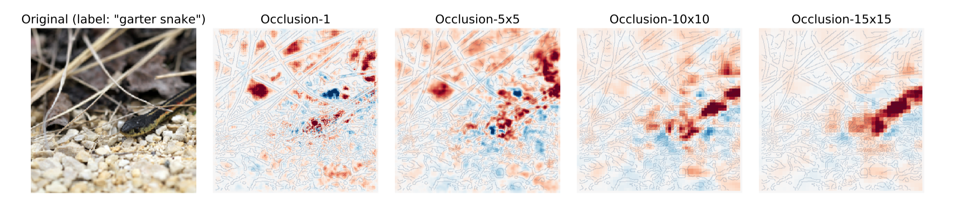
Occlusion-1 / Leave one out
Easy!

Slide 28
Probing
What BERT learned
What BERT might not learn
What is a good prob

Slide 29
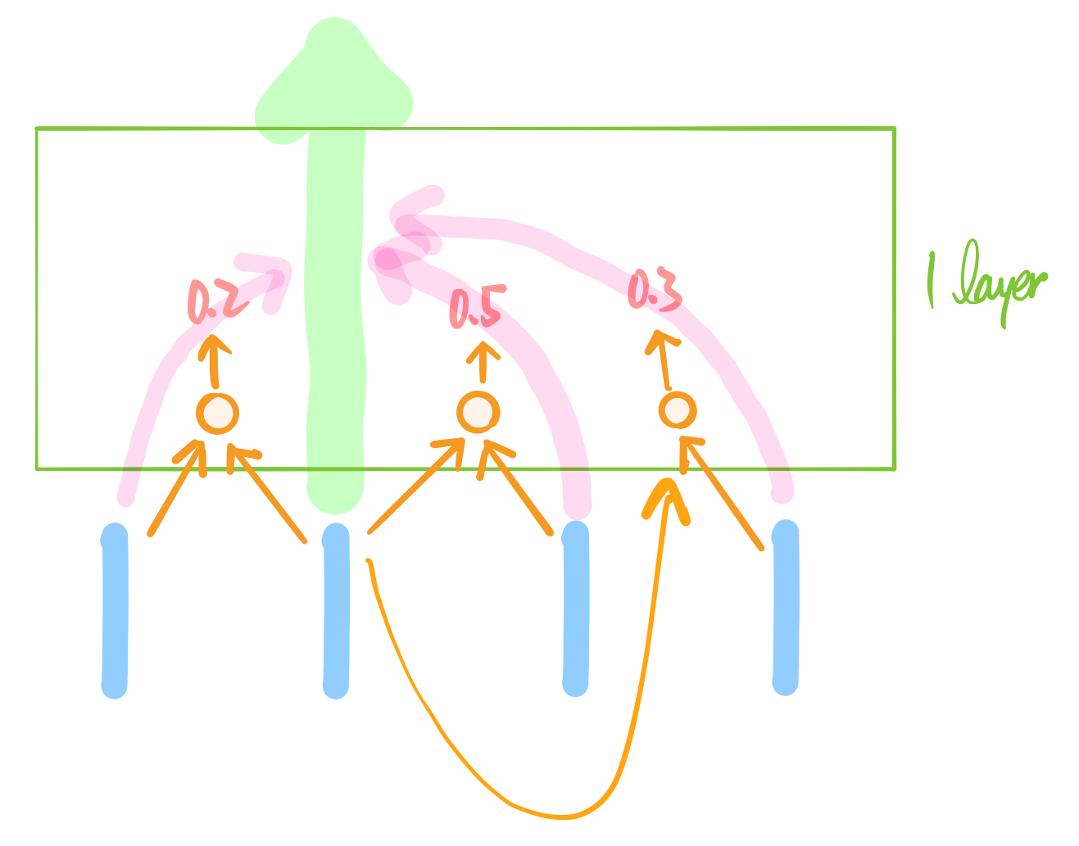
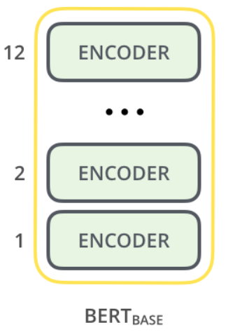
Background: BERT architecture

Slide 30
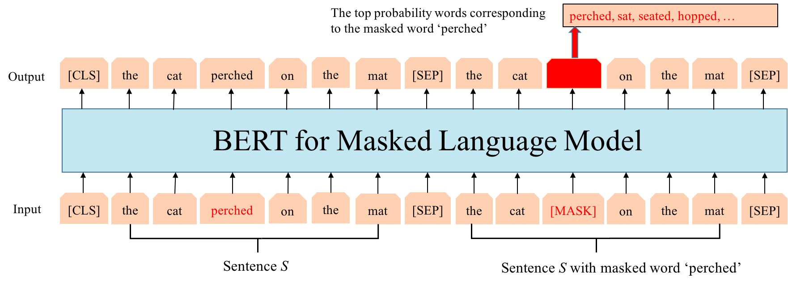
Background: BERT training
Masked language model
Next sentence prediction

Slide 31
Key points
Despite simple training targets…
BERT representation + simple model
>>>>> Classic representation + complex & well-designed model
During forward, what information is encoded in each hidden tensors?
To know what is learned and what is not
Methodology
Find a representative task
Do some simple trick on each hidden tensor trying to accomplish the task
Small classifier
Distance between tensors

Slide 32
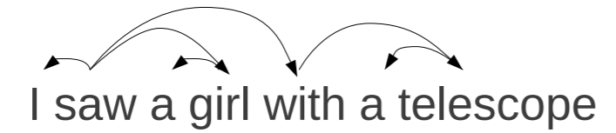
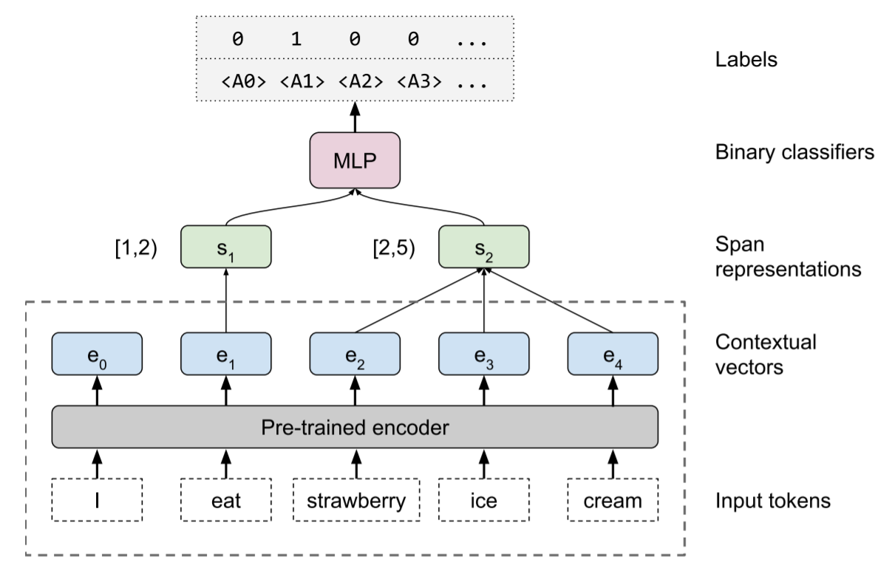
What does BERT learn?
Probing tasks
Part-of-speech, constituents, dependencies, entities, semantic role labeling
Coreference, semantic proto-roles, relation classification
Classifier - Edge probing technique
Some tasks are per-word classification
Part-of-speech
Some tasks are relation between words
dependencies
Input of linear classifier:
A word
A word with a span

Slide 33
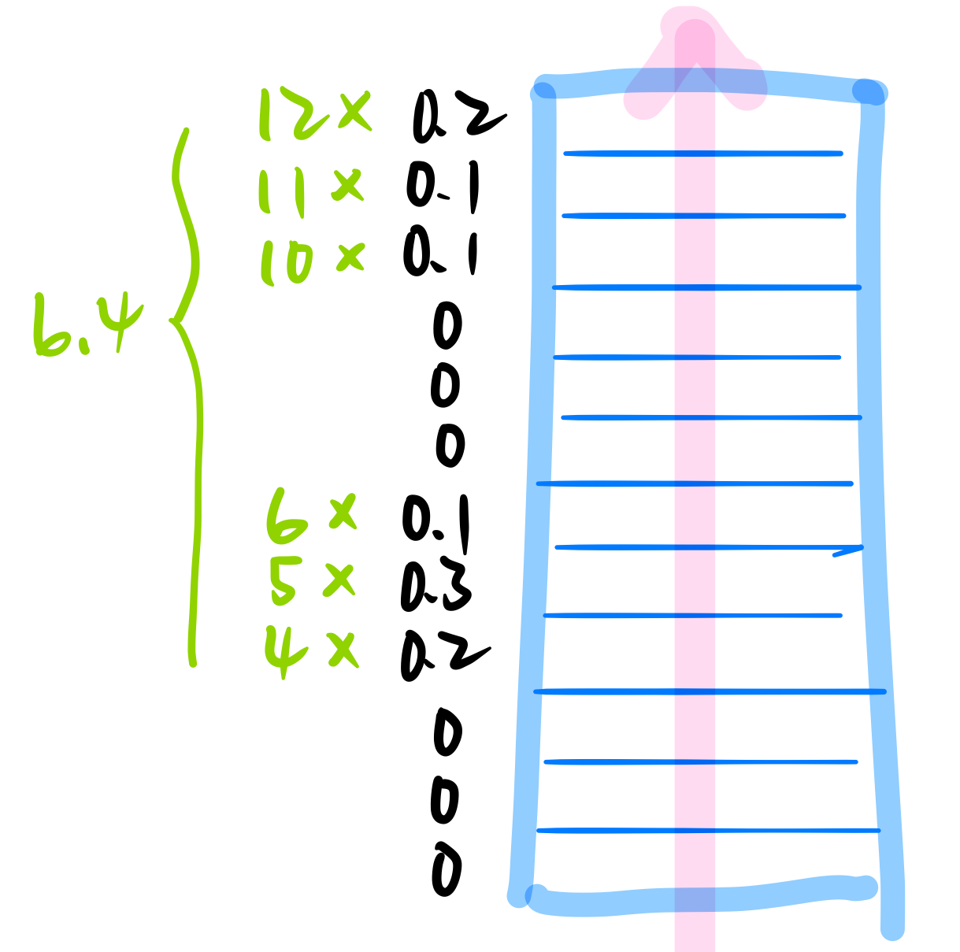
Evaluation
Center of gravity
Train 12 scalars

Slide 34
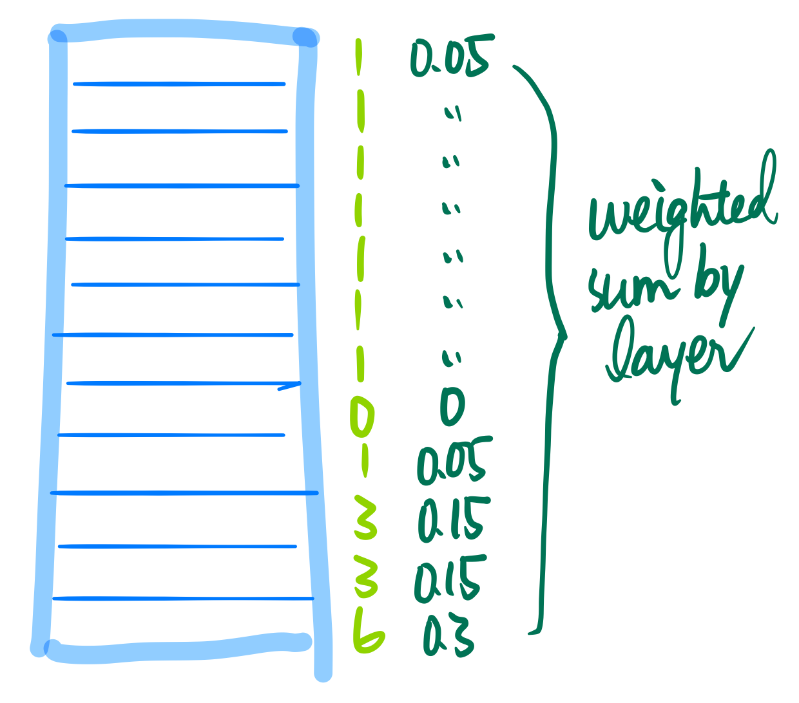
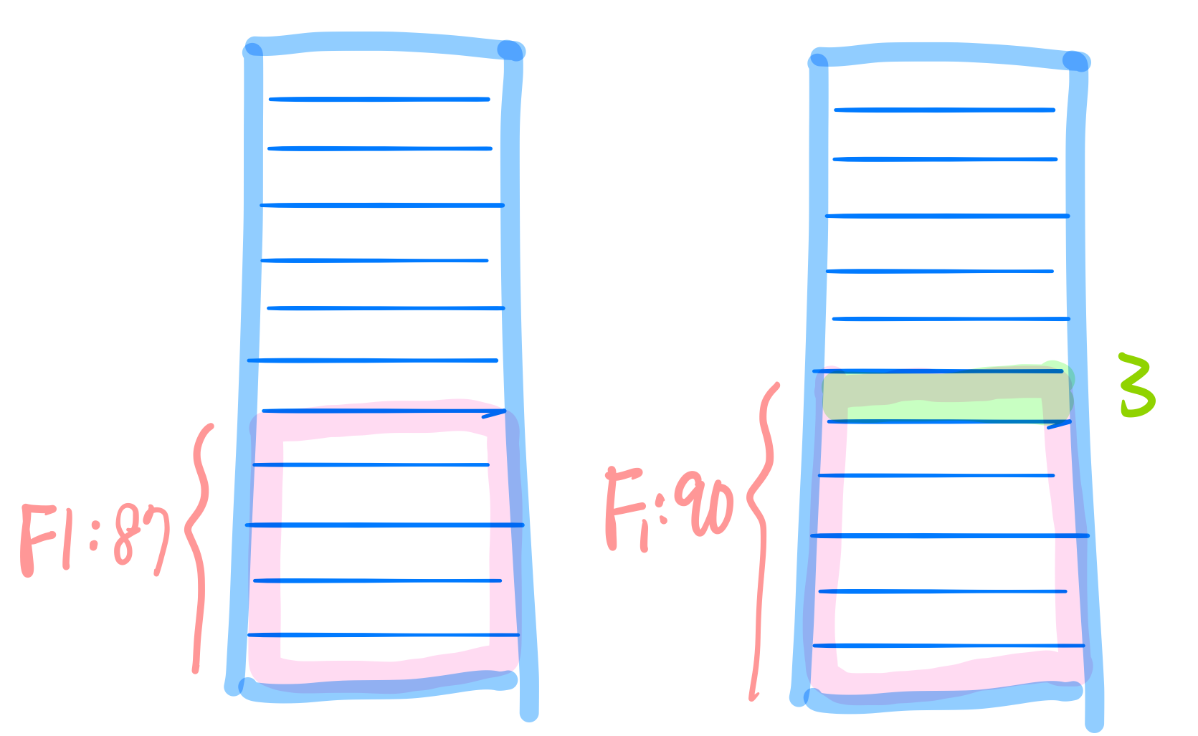
Evaluation
Cumulative score
Effect of introducing a new layer

Slide 35
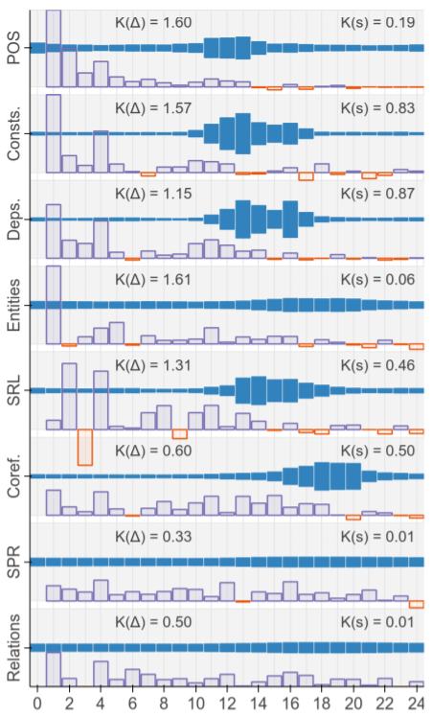
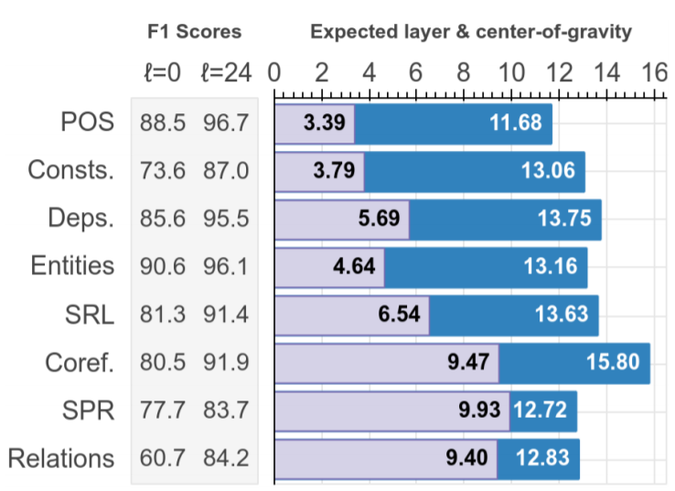
Dark (blue) are the mixing weight center of gravity
light (purple) are the expected layer from the cumulative scores

Slide 36
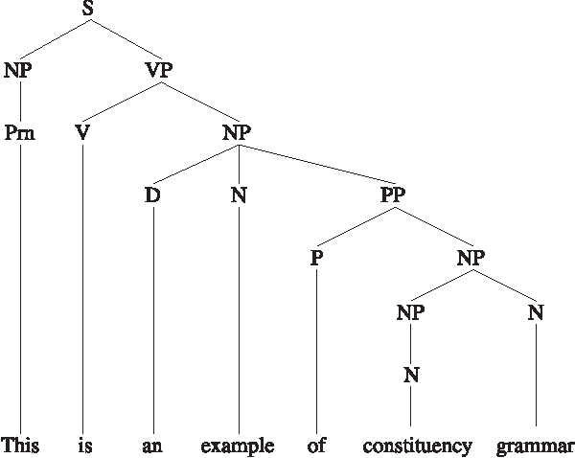
What does BERT might not learn?
Probing task: Unsupervised constituency parsing
John talked to the children about drugs
John talked about drugs to the children

Slide 37
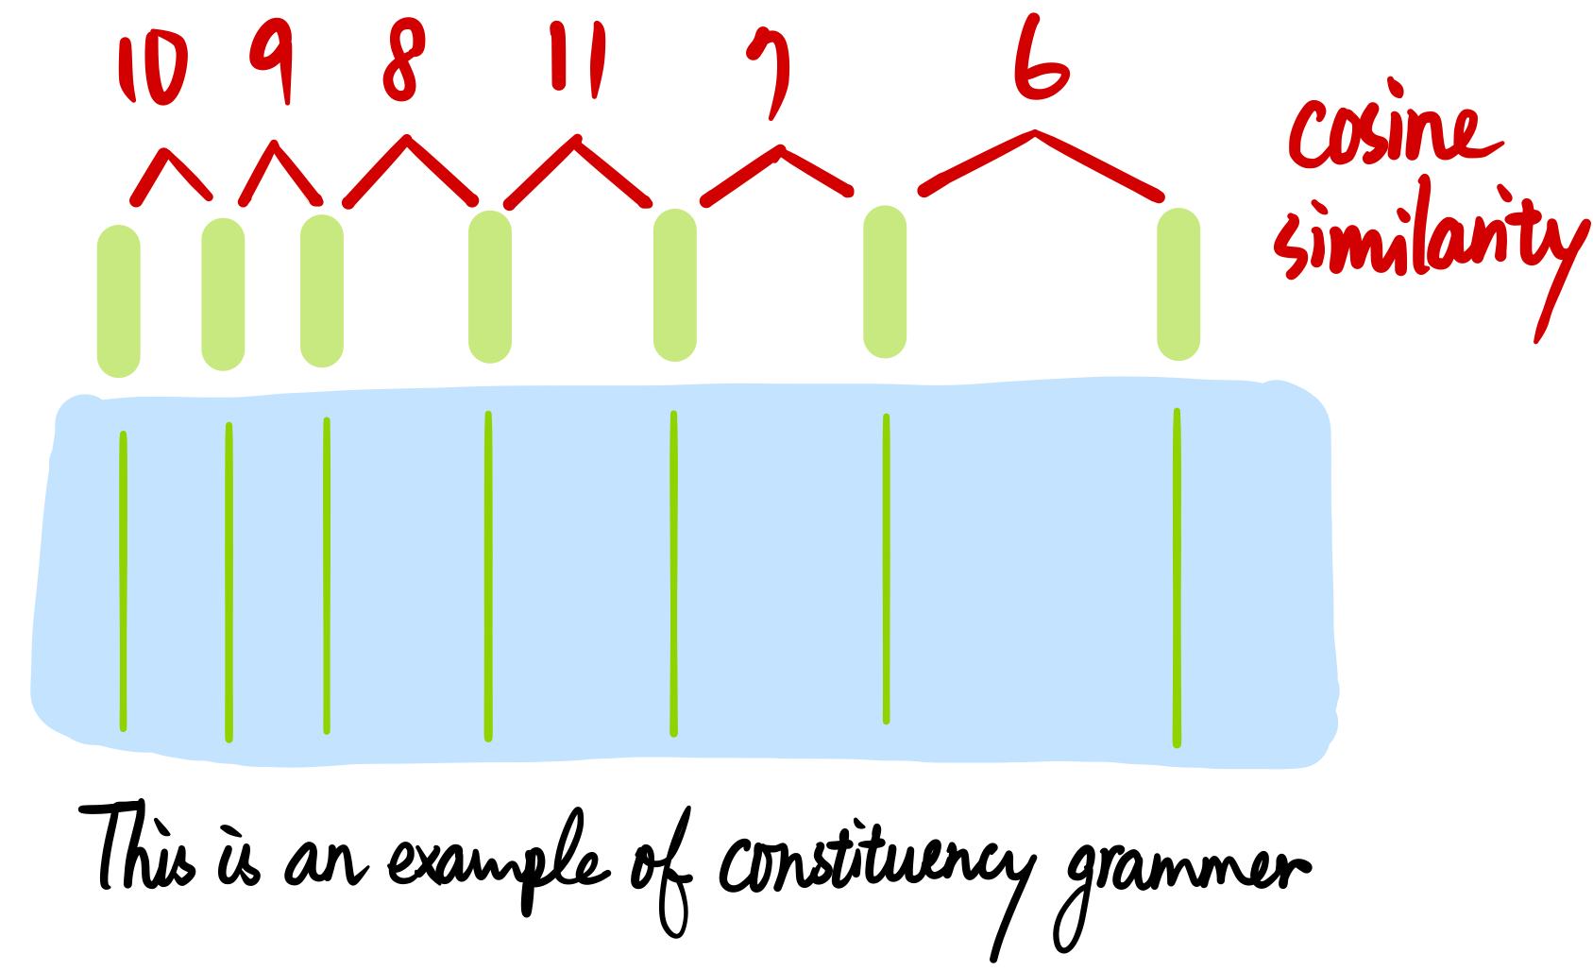
Unsupervised constituency parsing

Slide 38
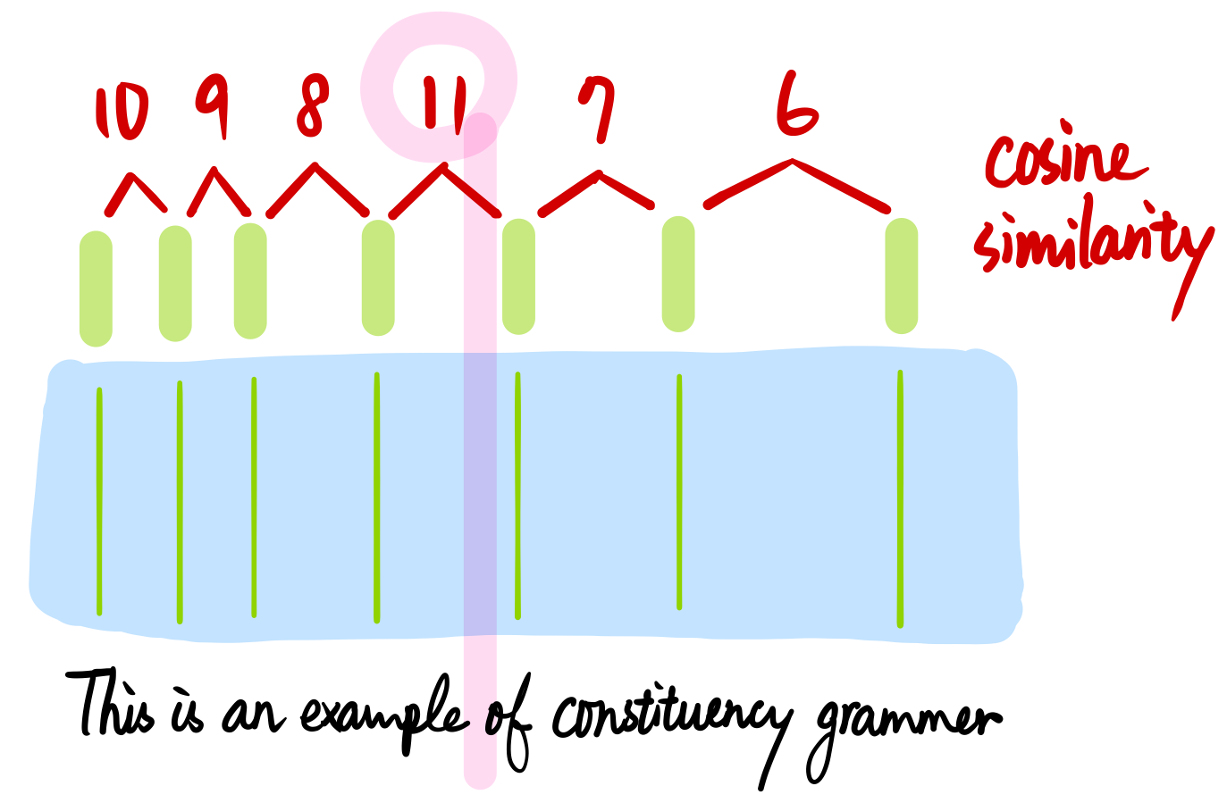
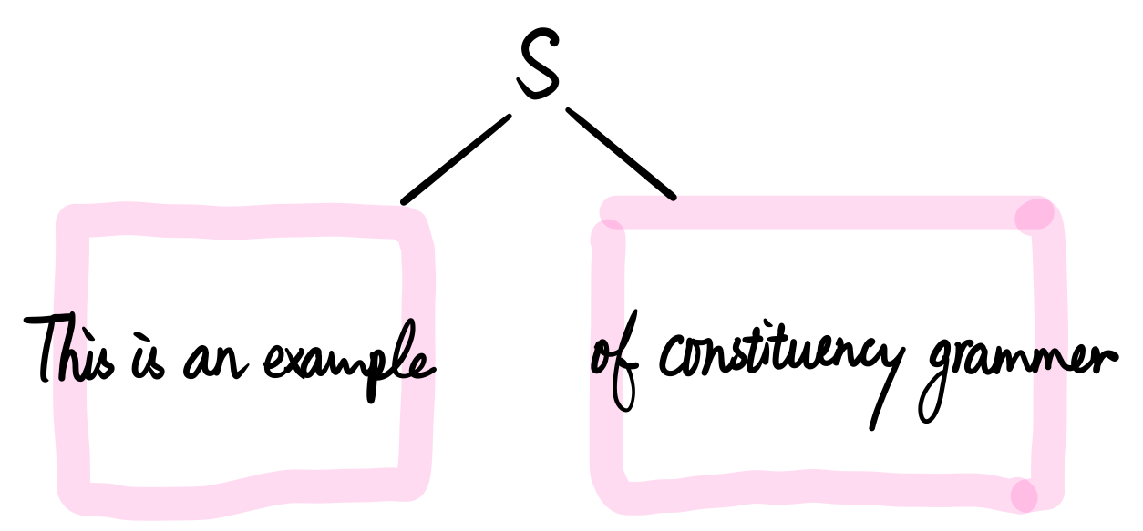

Slide 39
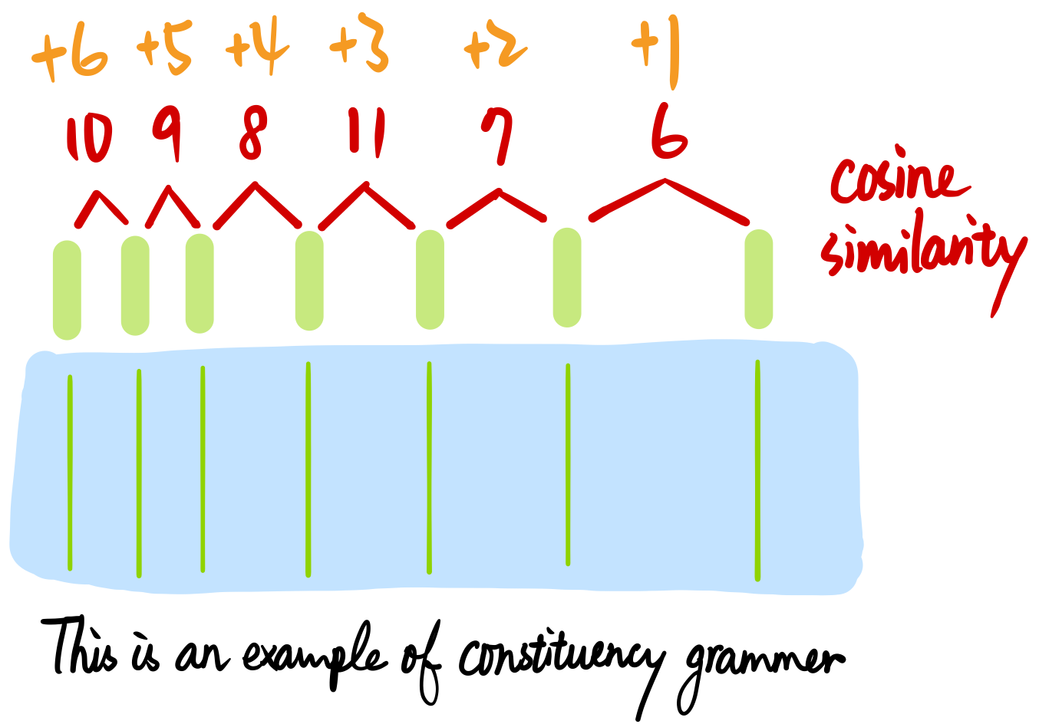
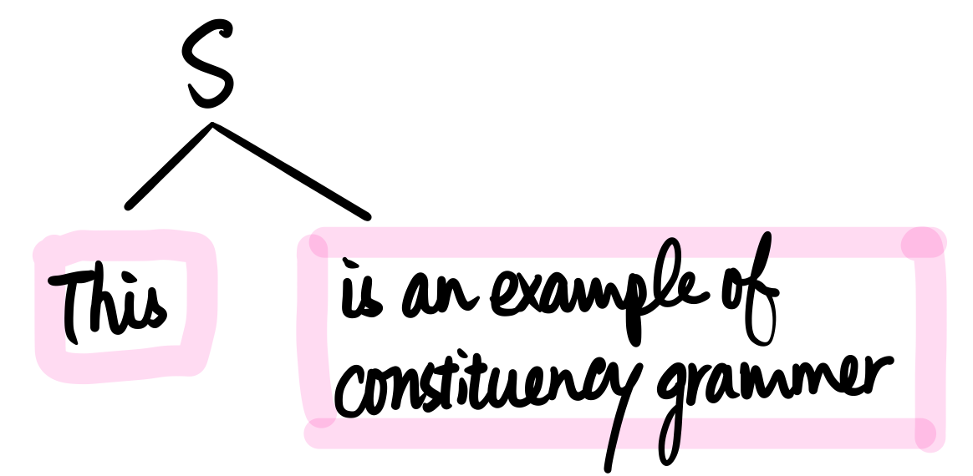
Compare with adding right-branching bias

Slide 40
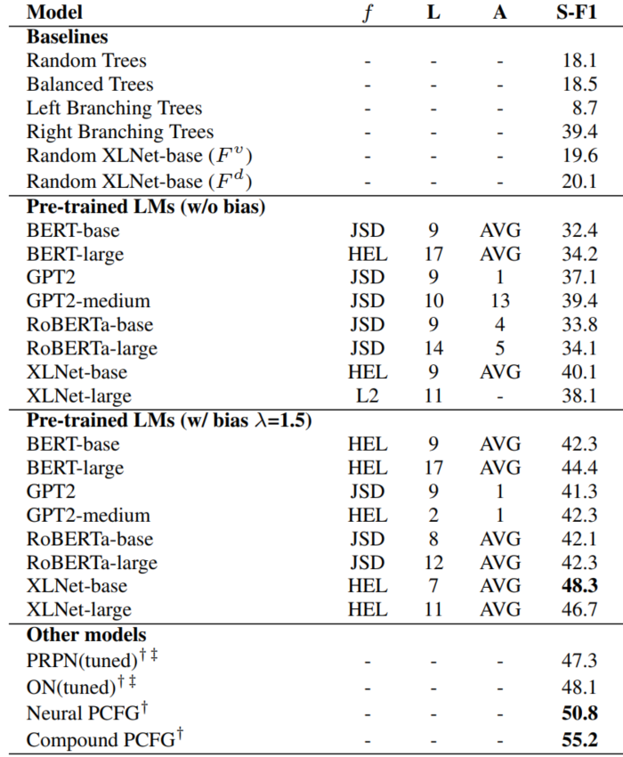
Observation
Bert MIGHT not aware of simple right-branching nature
At least such information can not be easily extracted
Is this important?
Depends on your use-case
Know more about your representation
Eg. ELMO1 vs ELML2

Slide 41
What is a good prob?
Linear classifier?
Not all information can be linear separable
Multi-layer perceptrons?
How many layers?
Maybe it is just the probing model that learns the downstream task!

Slide 42
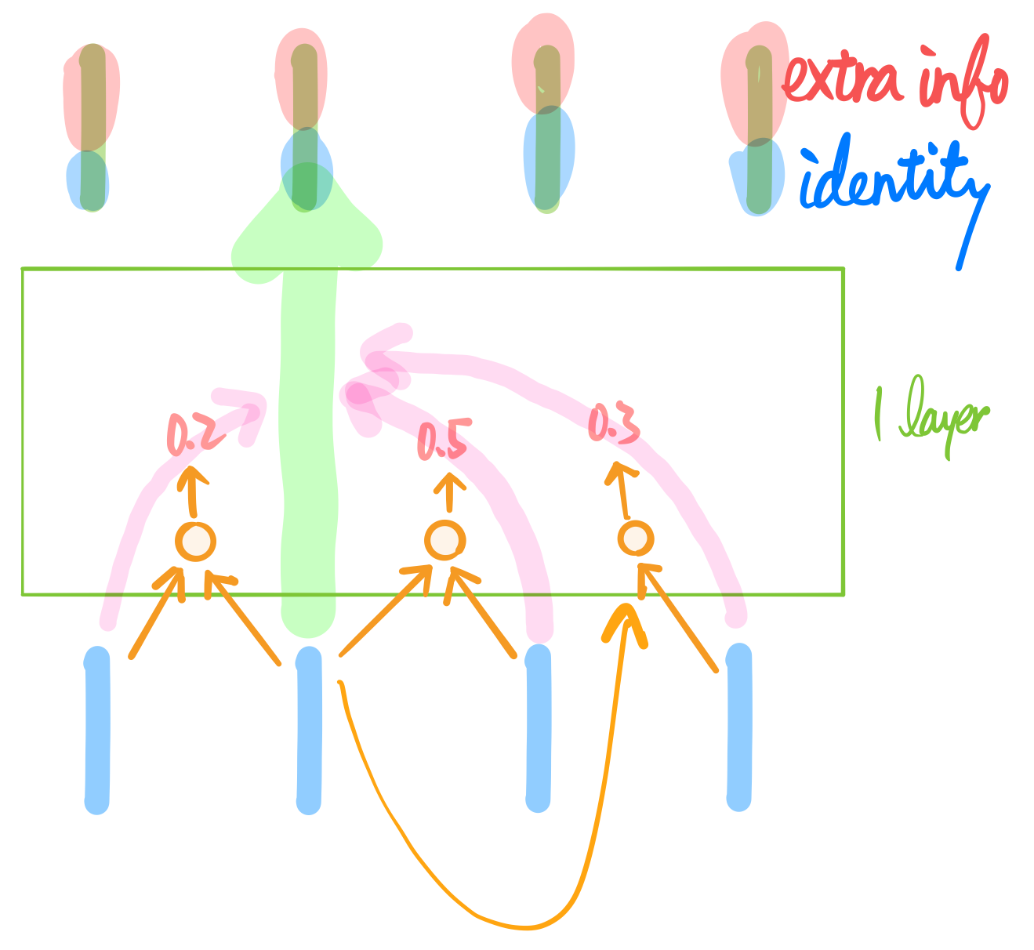
Representation
contains...

Slide 43
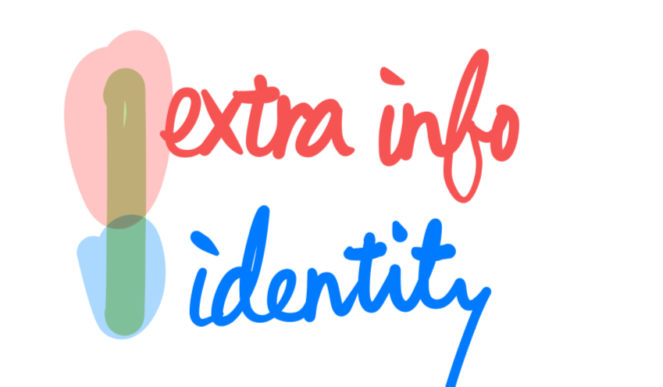

What is a bad prob?
Too large capacity… how to define?
If ...
The prob can recognize the word identity from the representation
The prob can map any word to any predefined label

Slide 44

A closer look...

Slide 45
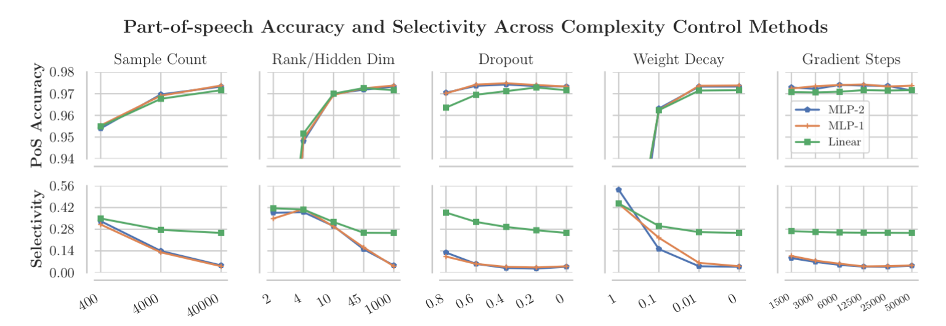
Selectivity (higher is better)
Acc on original task - Acc on constructed task
Probing model suggestion: linear / mlp with high selectivity

Slide 46
Heatmap
Activation map
Attention map

Slide 47
Activation map: CNN dissection
Does activation map reflect some semantic concepts?
Concepts: objects, parts, scenes, textures, materials, and colors
Dataset: Broden (released)
Concept labels at PIXEL level
CNN trained on large categorical classification dataset (eg. ImageNet)
Evaluate using Broden dataset

Slide 48
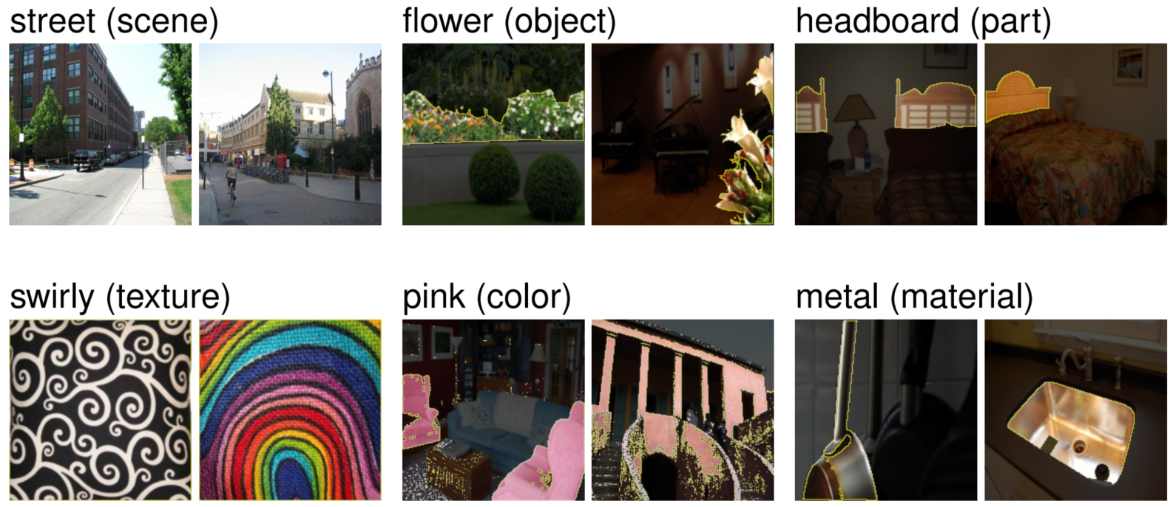

Slide 49
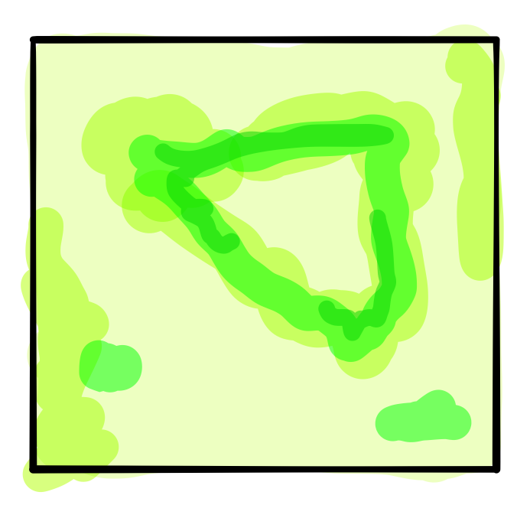
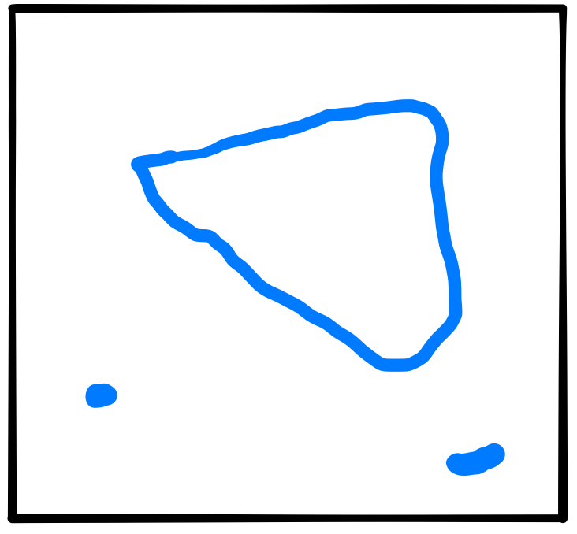
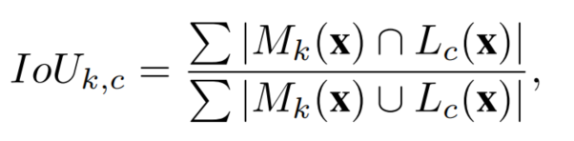


Evaluation

Slide 50


Slide 51

Attention map as explanation
/ DNN
Query

Slide 52
Attention as explanation?
Complex encoder can entangle inputs together
Query

Slide 53
Is attention consistent with attribution?
Methodology: Calculate correlation between attention & attribution
Attention v.s. Gradient when LSTM
Attention v.s. Gradient when DNN
Attention v.s. Leave one token out performance drop when LSTM
/ DNN
Query

Slide 54


Slide 55


Correlation between Gradient / LOO is high

Slide 56


Why believe attribution?
When LSTM-based attention gets good performance...
If such attention weights reflect importance
Use attention as fixed guide to train a DNN-based classifier!
Attention might reflect importance!
How about compare with attribution?
When can we ascribe performance to attention?

Slide 57
Take-away message
When encoder is DNN → Attention is explanation
When encoder is contextualized → Unclear
One can first verify the effectiveness of attention by Guided-DNN framework
(compared with uniform attention)
Relation with classic attribution methods → Unclear
Further reading:
On Identifiability in Transformers
TLDR: Despite contextualized self-attention, identity from raw input remains
Implying attention is explanation for transformer

Slide 58
Create an explainable model

Slide 59
Some difficulties in explaining CNN
Activation map is complicated in final layers
We only know they represent higher level semantics
Combination of low level activations
Visualize a category meaningfully is not easy
There are nonsense images which still be classified as the specific category

Slide 60

Constraining activation map
Interpretable Convolutional Neural Networks
At some final layer, regularize the activation map as some templates
The paper design the loss with complicated information theory...
The idea is in fact quite intuitive

Slide 61


Slide 62

Encoding prior
What is prior? What a good image looks like!
Deep dream
By itself, that doesn’t work very well, but it does if we impose a prior constraint that the image should have similar statistics to natural images, such as neighboring pixels needing to be correlated.
So here’s one surprise: neural networks that were trained to discriminate between different kinds of images have quite a bit of the information needed to generate image.

Slide 63

Encoding prior
Discriminative model: typical CNN
Modeling conditional distribution P(Y | X)
Generative model
Modeling joint distribution P(X, Y)
P(X, Y) = P(Y | X) * P(X)
Combine together?

Slide 64



Generative CNN (detailed slide)
Your Classifier is Secretly an Energy Based Model and You Should Treat it Like One
If somehow (by energy-based training)
Then
f_{θ} (x)[0]

Slide 65

Generative CNN
Now the logits directly contain prior information

Slide 66



Generative CNN
Forward: Classifier
Backward: Image generator
Easy to visualize a category, simple backward can get valid image!

Slide 67

Adversarial training for encoding prior
Image Synthesis with a Single (Robust) Classifier
Probably the most easy way to encode prior
Using attack technique to do data augmentation
No theory, but empirical success!

Slide 68



